Slide 1

I
C
C
BIM & Digital Twins for Leasing and Property Management

Slide 2
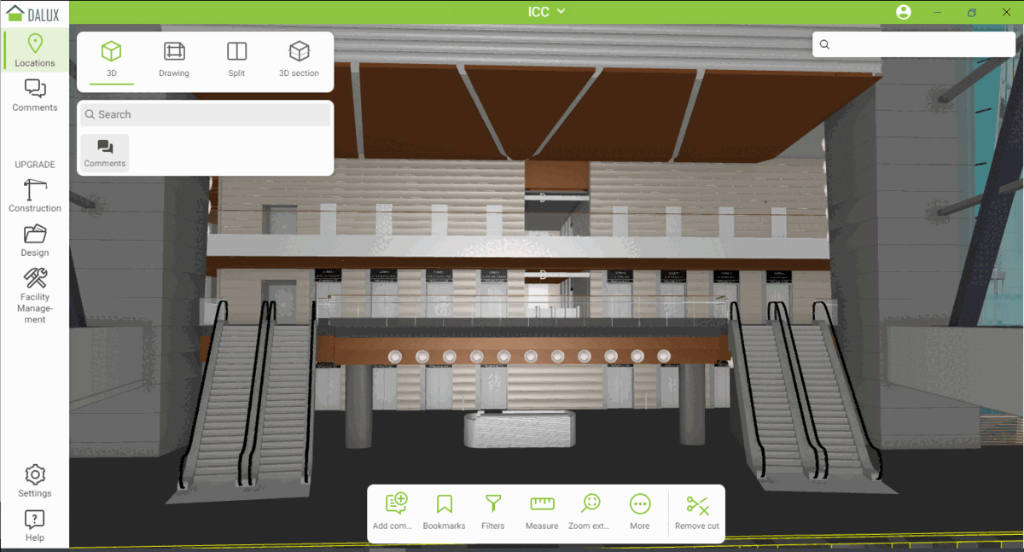
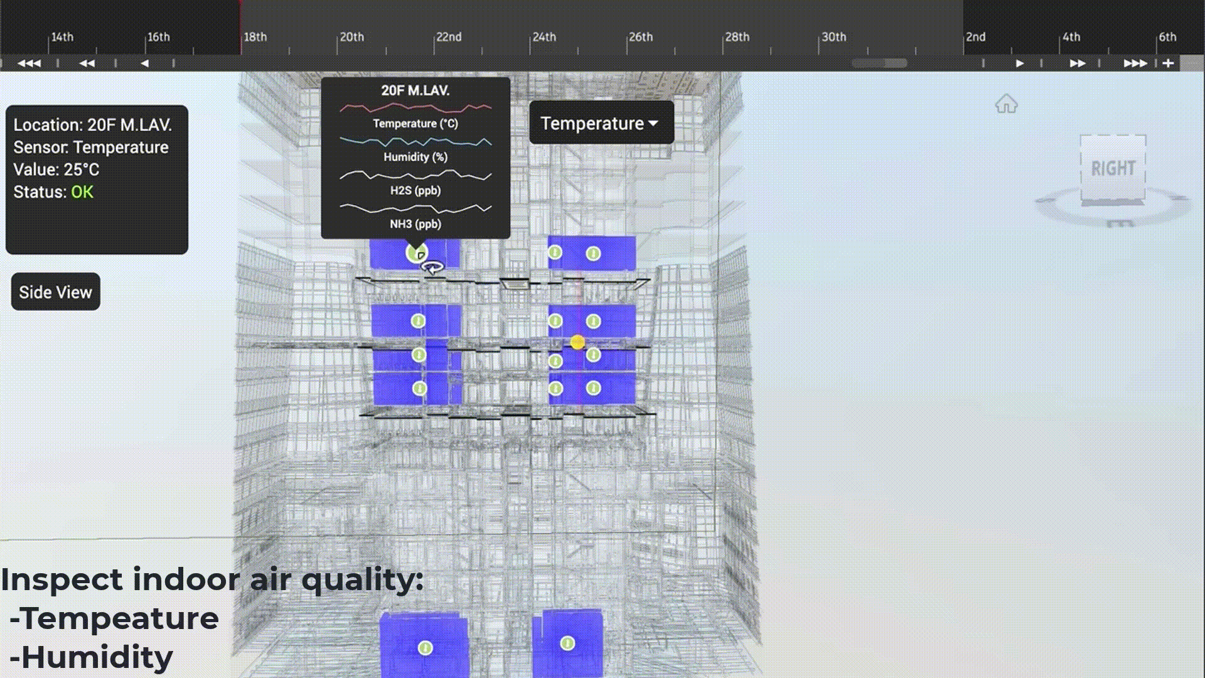
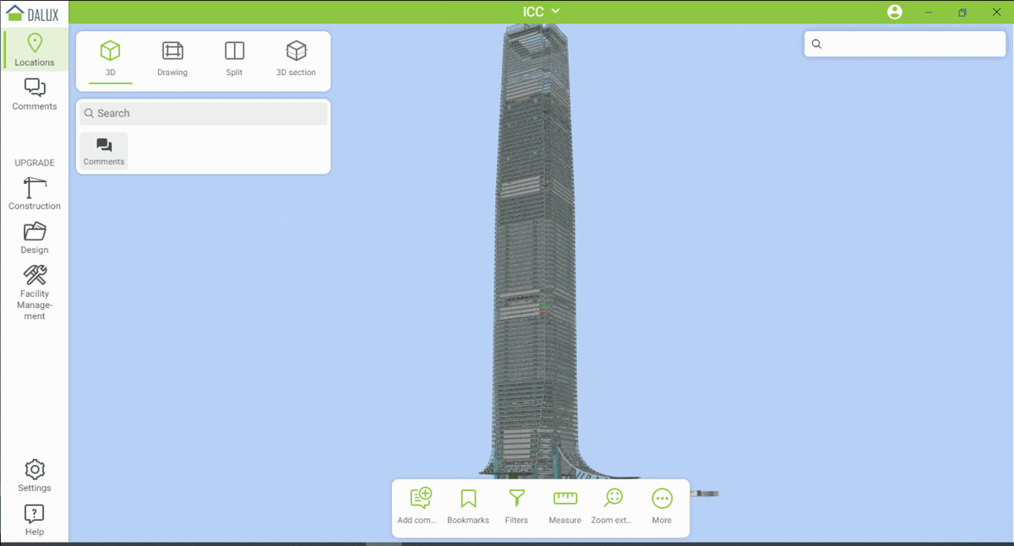
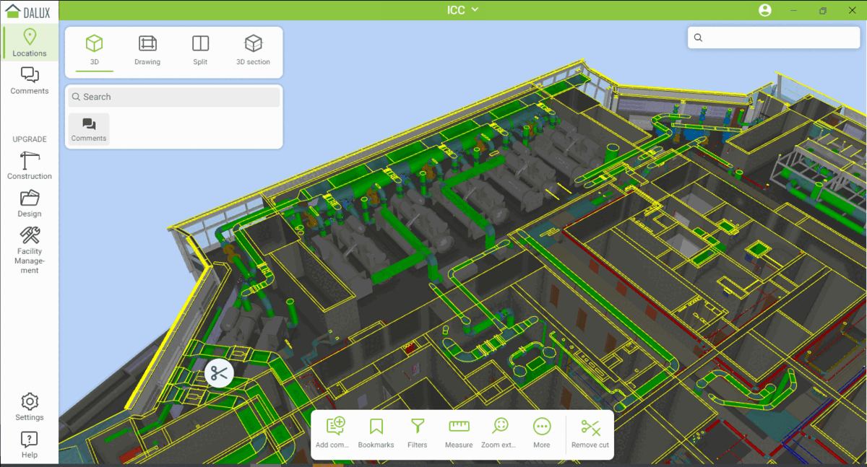
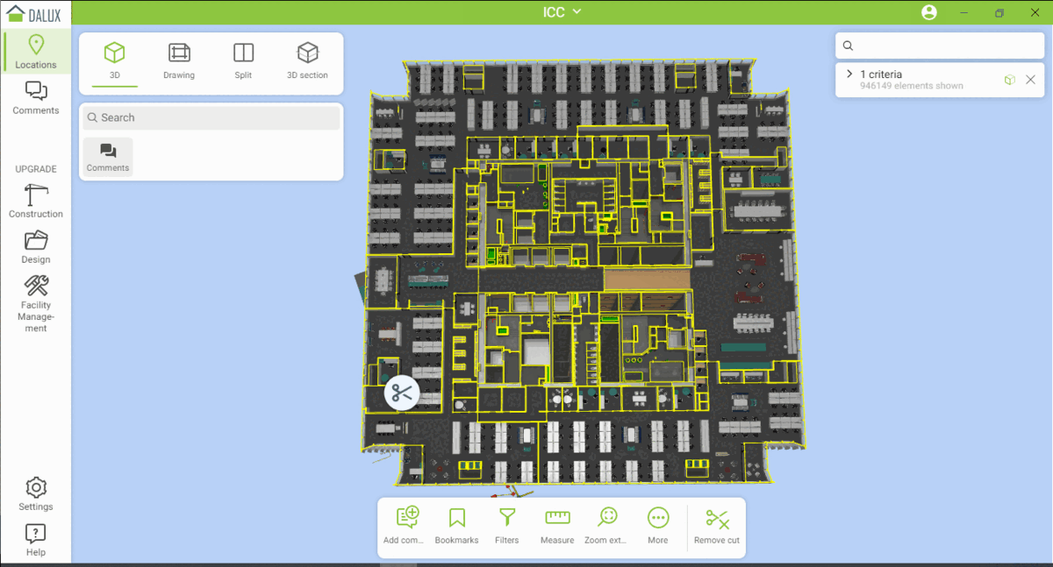
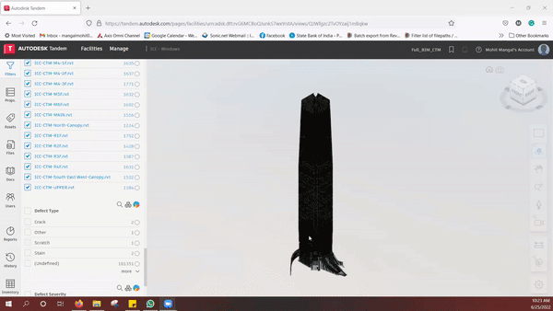
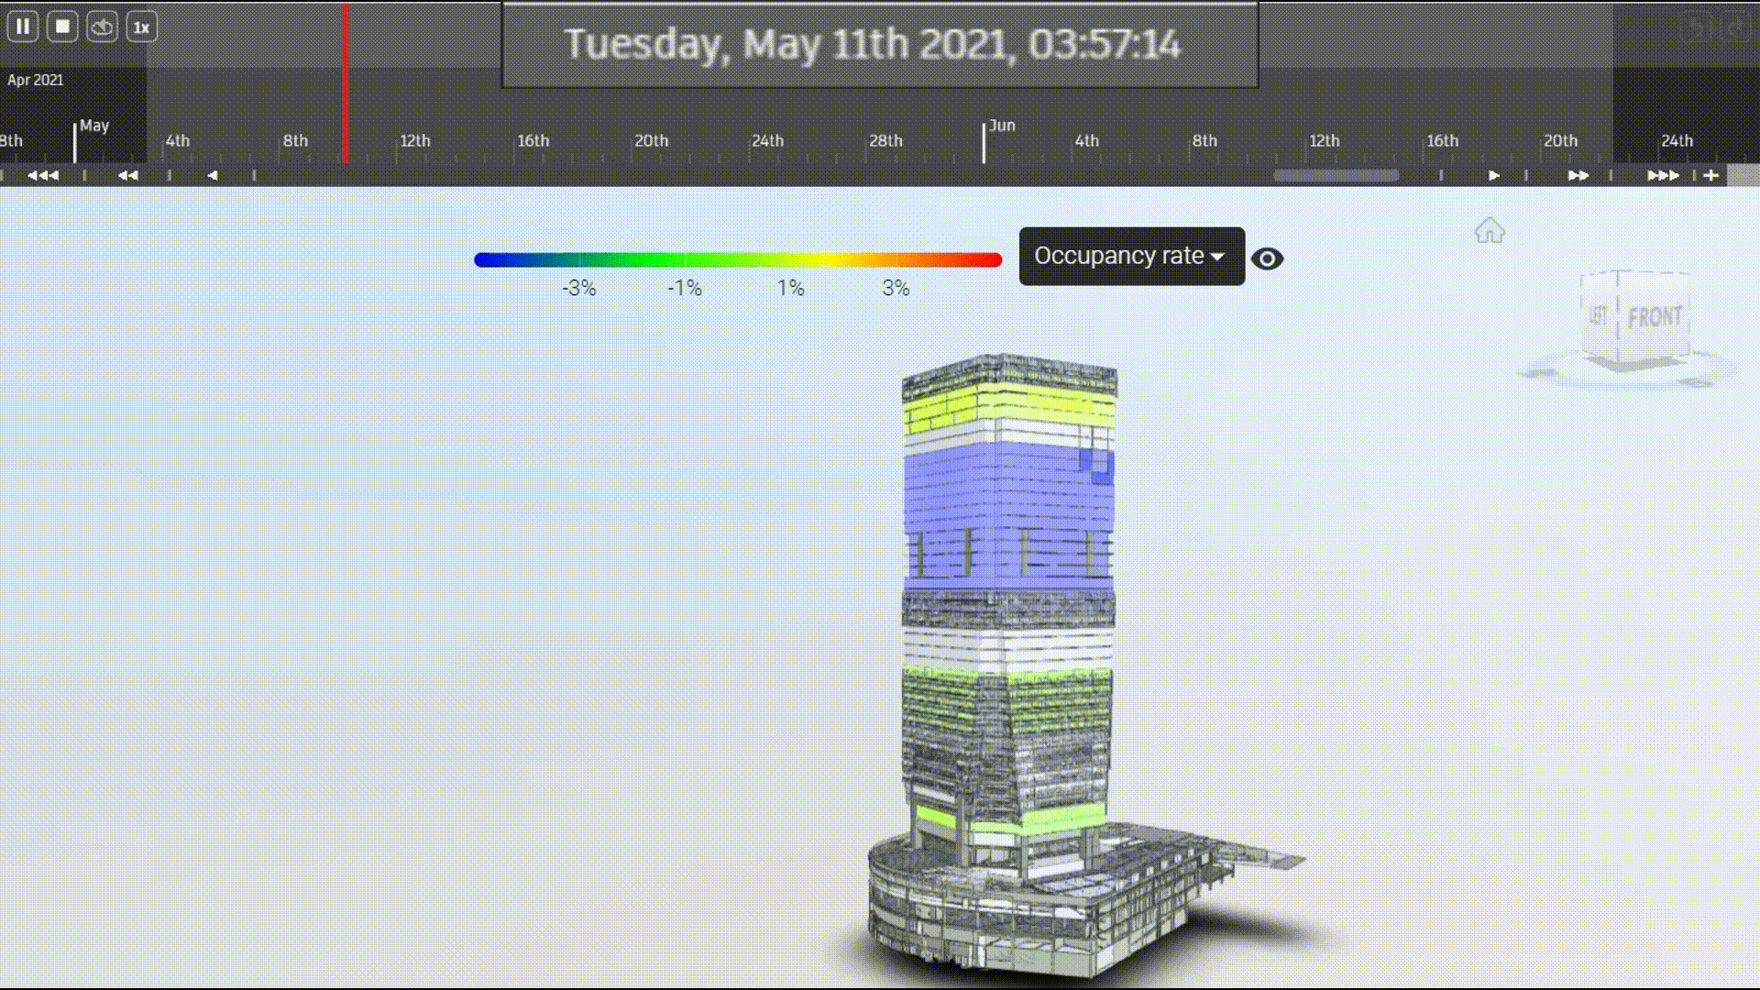
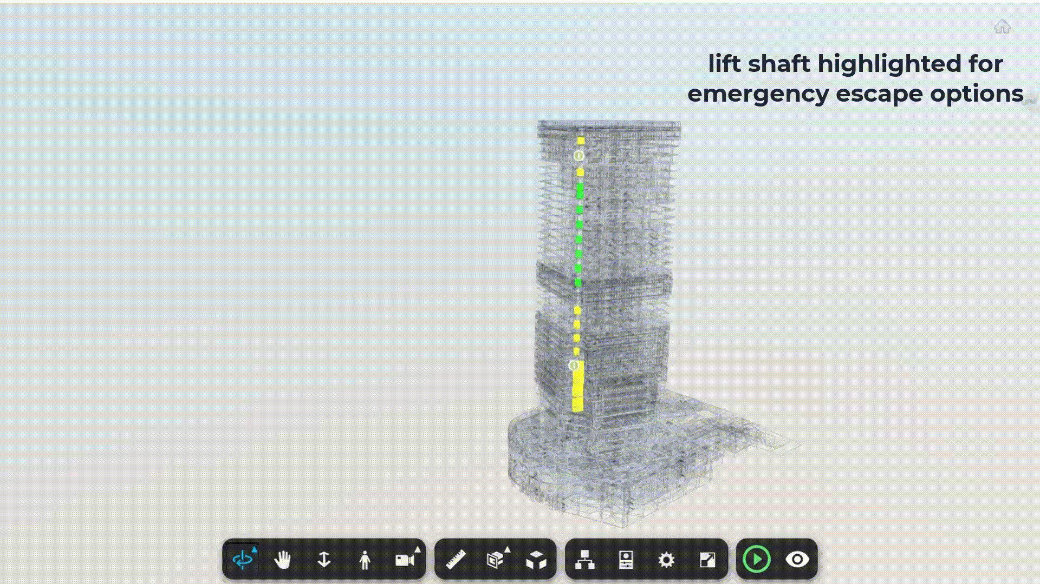

Slide 3

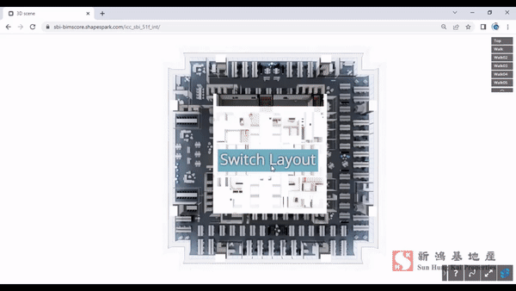
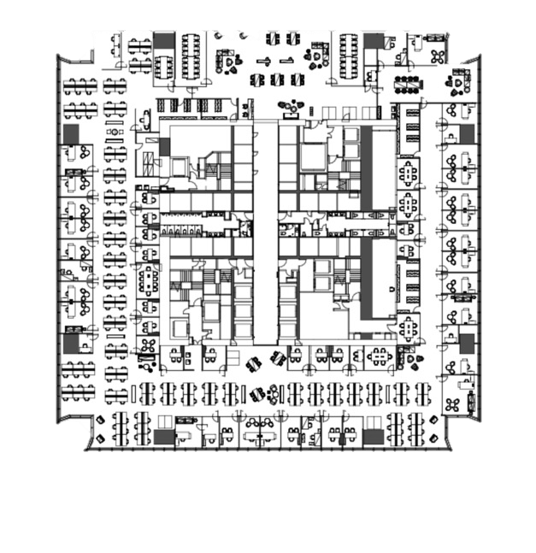
Floor layout option illustration for prospective tenants
Digitalized
Conventional
Passive
Line Drawings
Engaging
Simulated Environment

Slide 4
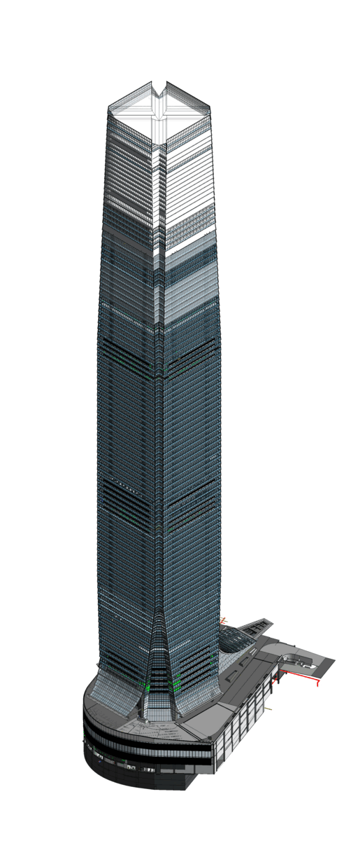

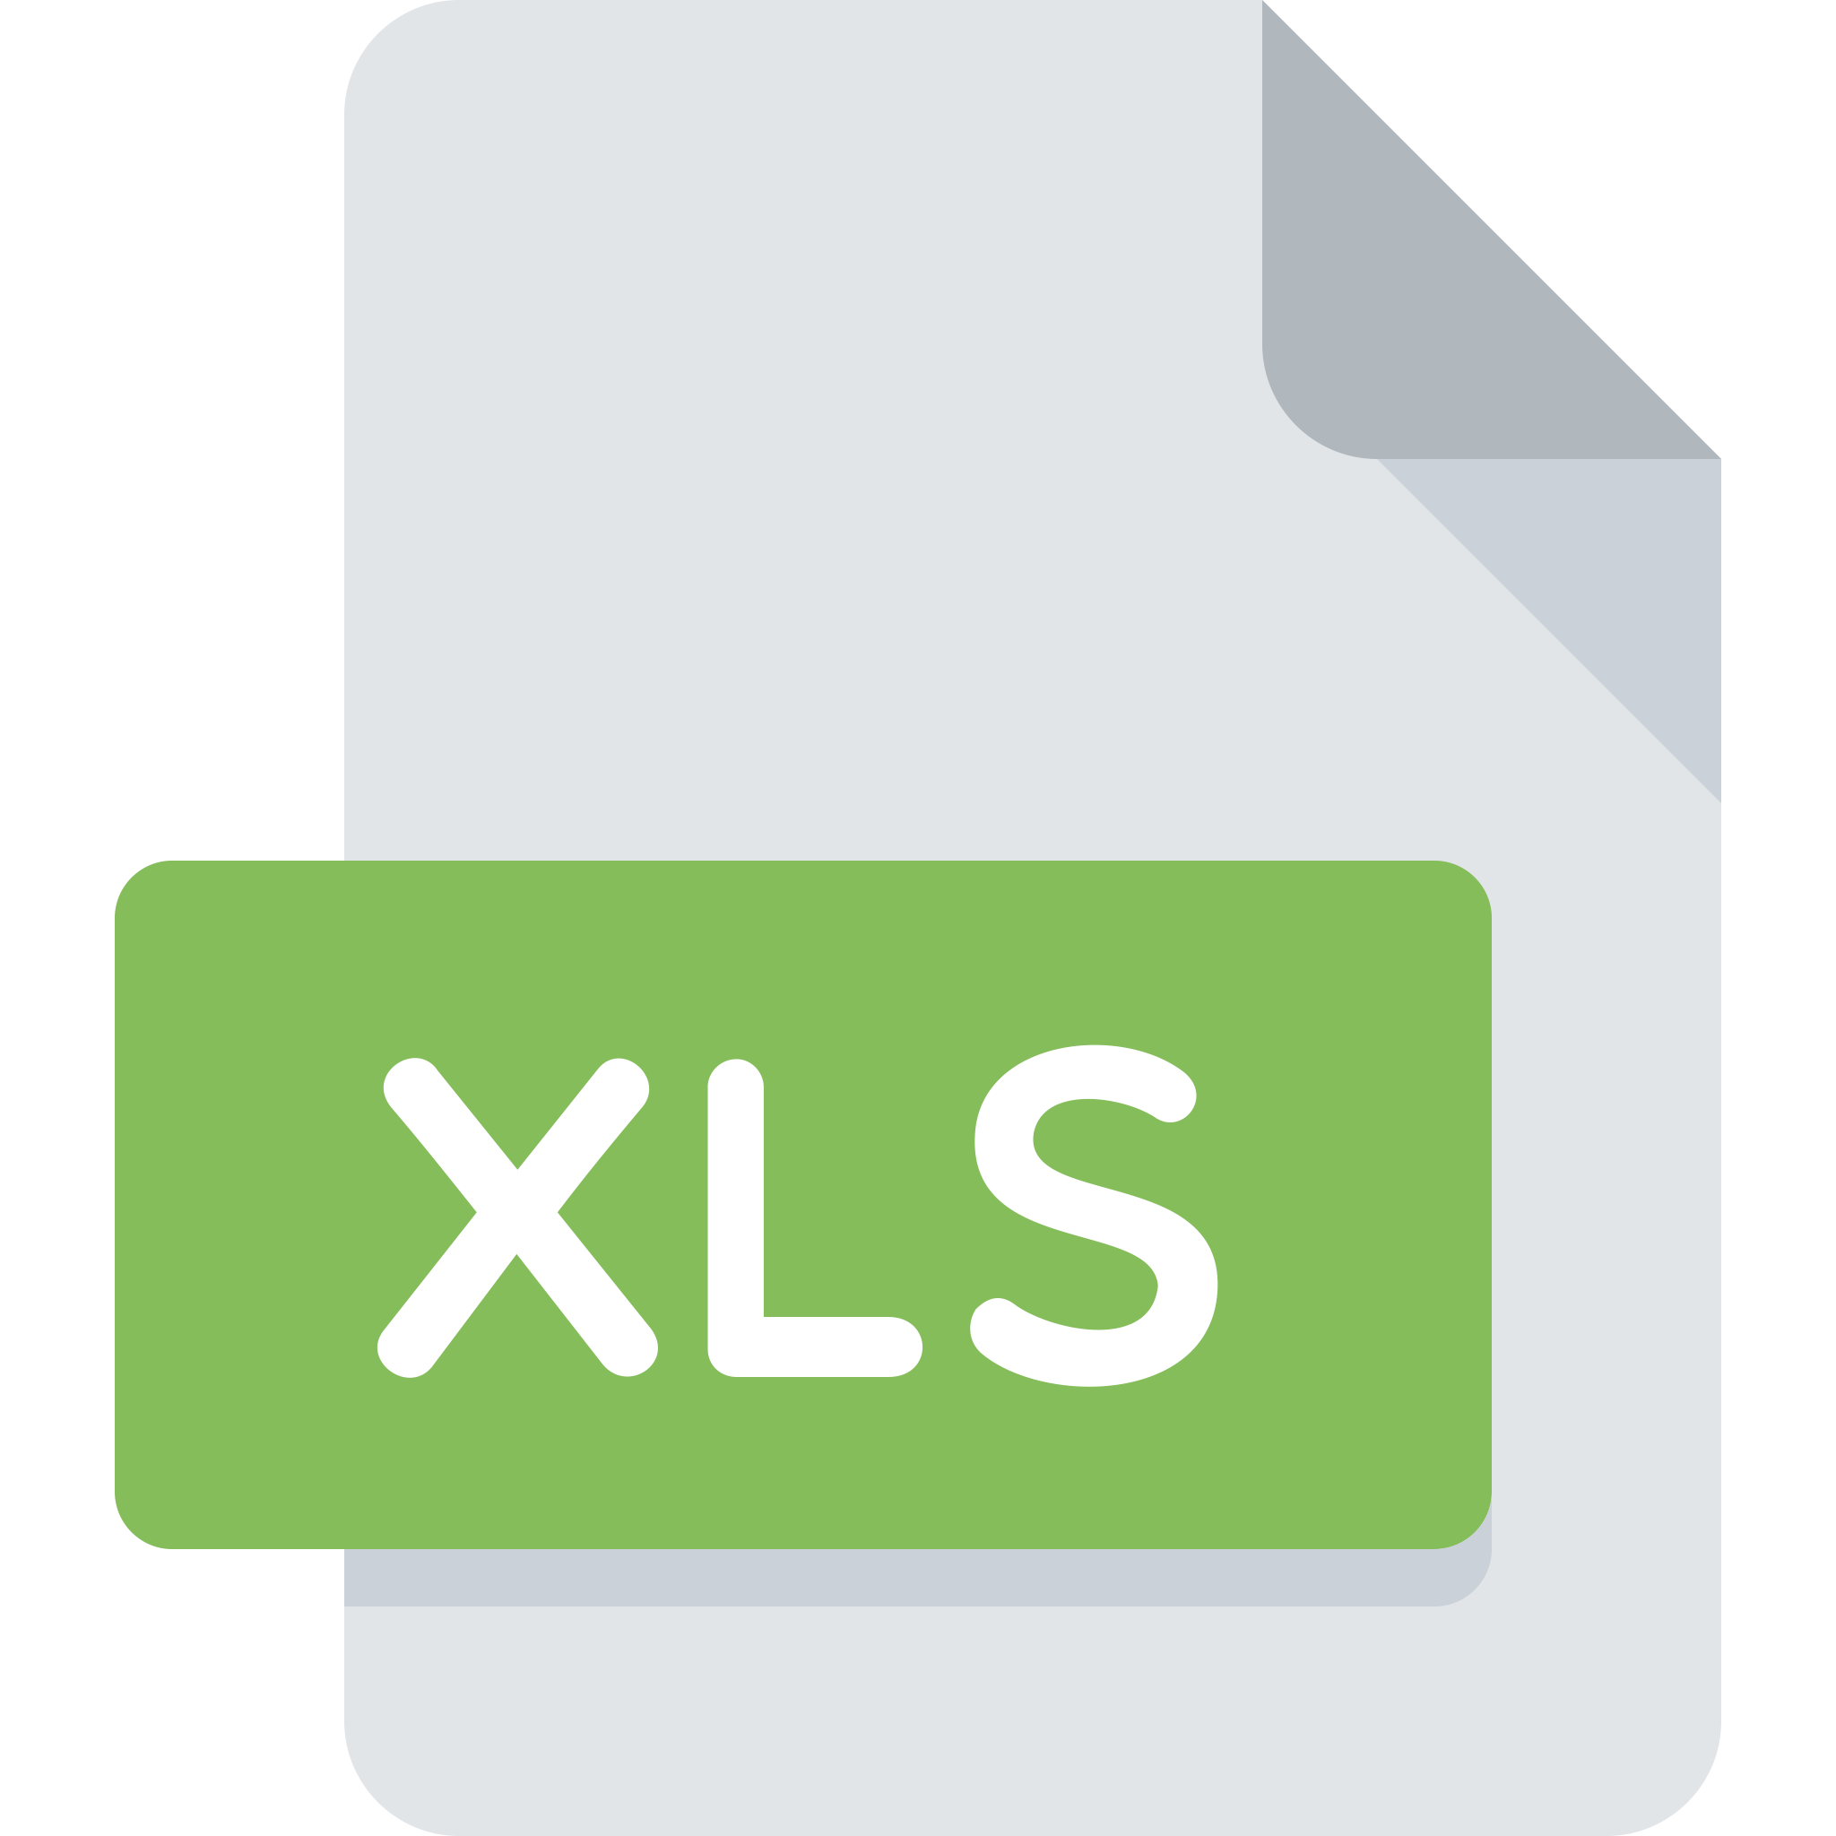


Traditional Approach
Emerging Practice
Query, Add and Update Assets
Paper Labels
QR Code
Dig through folders
One-click Away
O&M manual
Preventive maintenance plan
Maintenance Work Planning
Spreadsheet
Cloud-based Scheduler
Manually Populate
Automatically Generate
DWG
Inventory Query & Management
Maintenance
report & history
Technical info
& drawing
Excel & Marked-up Dwg.
Online Record & 3D
Cumbersome
Intuitive
New Staff On-boarding
口耳相傳
Standardised Knowledge
IoT sensor data
BMS data
CSD, System Diagrams
Colour-coded Routings
etc

Slide 5
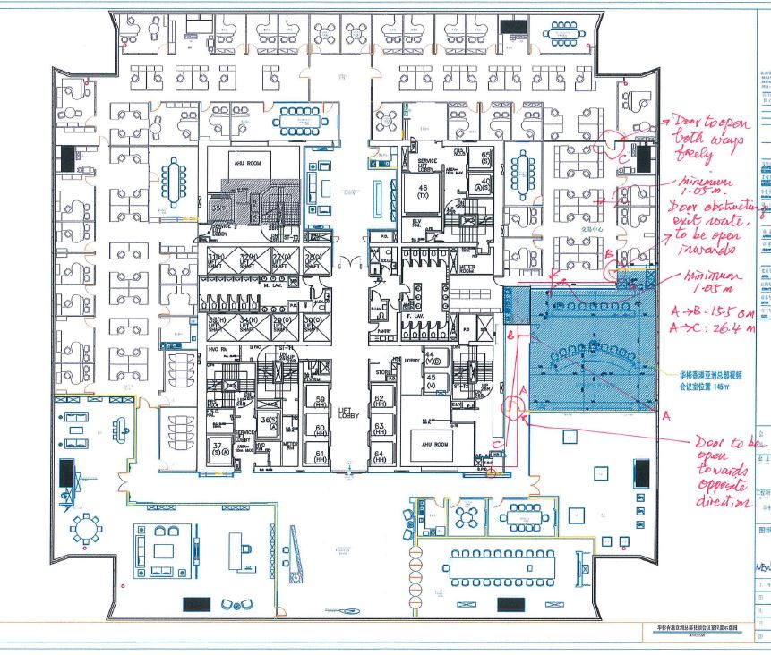
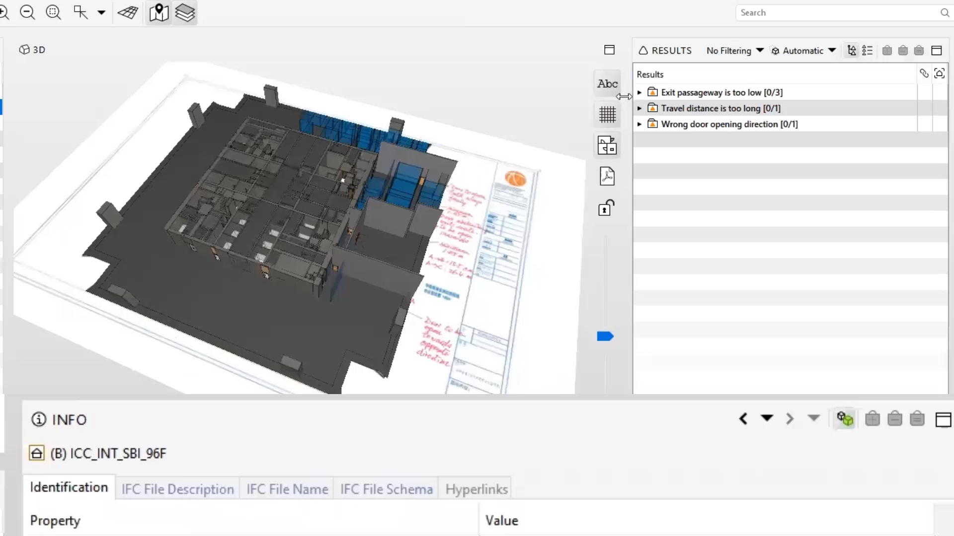
Conventional
Digitalized
21-day Turn Around Time
Dependent on AP Availability
Automatic Checking Results
(Under Development)

Slide 6

Sales and Marketing
Conventional
Digitalized

Slide 7
